Slide 1
Analysis of Average Clicks on Online Advertisements
By Erick Plaza

Slide 2
Overview
As an Advertising Company, our goal is to maximize clicks when we post an ad on a website.
To achieve this goal, we will need to predict what users will likely click on an ad based off of the features of that user.
I will analyze the traffic of multiple ads to determine which specific audience we should be targeting to maximize clicks.

Slide 3
Problem Statement
I am focused on the clicks per user since this is a key indicator to see if a user clicked on the advertisement or not.
I will also focus on the features of the users to narrow down a target audience.
My business partners want to use our marketing tools to specifically target the users based off of important features who are frequently clicking on the advertisements to drive more ad revenue.
This research will show which users we should be targeting to maximize our clicks (ad revenue).

Slide 4
Data Analyzed
In our dataset, we have the following variables:
‘Daily Time Spent on Site’: consumer time on website in minutes.
'Age': consumer age in years
'Area Income': Avg. Income of geographical area of consumer
'Daily Internet Usage': Avg. minutes a day consumer is on the internet
'Ad Topic Line': Headline of the advertisement
'City': City of consumer
'Male': Whether or not consumer was male
'Country': Country of consumer
'Timestamp': Time at which consumer clicked on Ad or closed window
'Clicked on Ad': 0 or 1 indicated clicking on Ad
Raw data available here

Slide 5
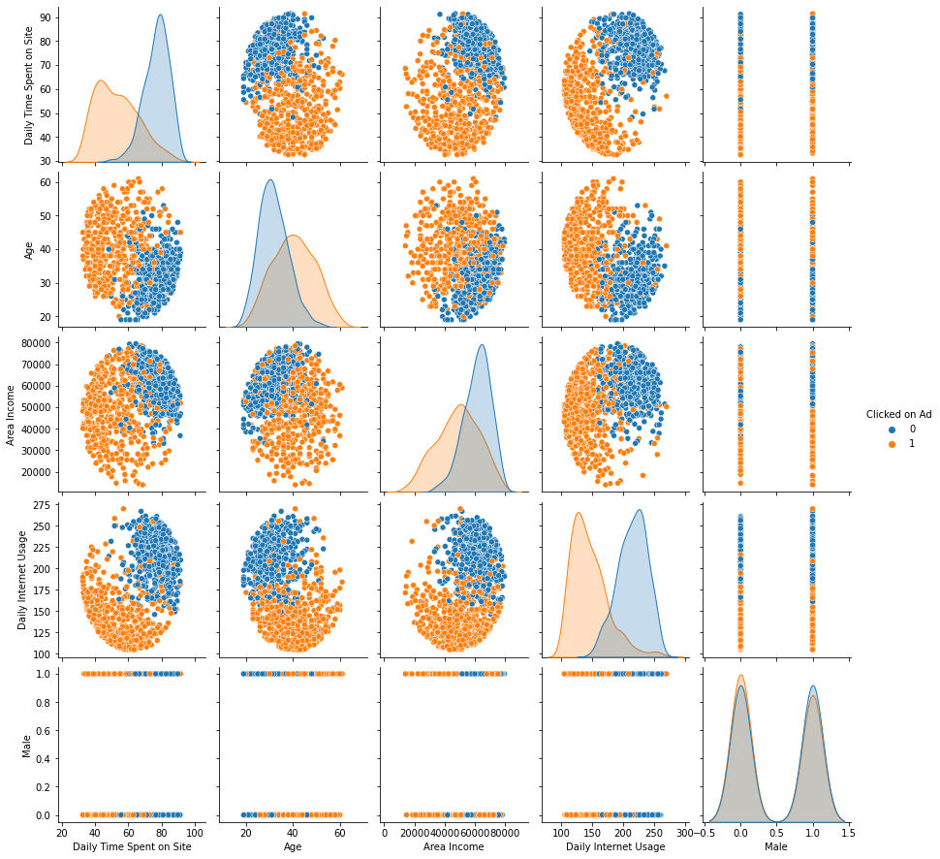
At a glance
Early exploratory data analysis was done with a pairplot to compare the relationships between the amount of clicks and user features.
Users who tend to click on the ad:
Spend less time on the website
Aged more relatively
Have less income
Have less daily internet usage

Slide 6
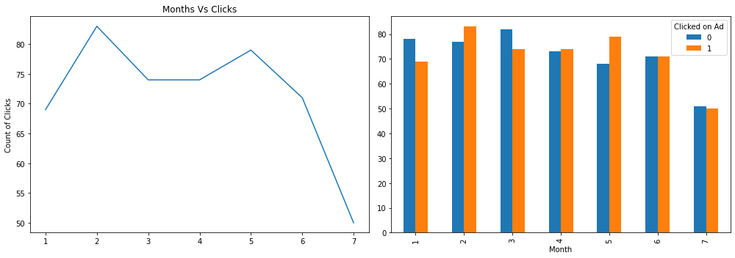
Additional features to consider
In the line chart (left) we can see that the amount of clicks is maximized in February (2nd month) & in May (5th month).
Then with the bar chart, we can see a more in-depth view of the amount of users who did or did not click on the ad.

Slide 7
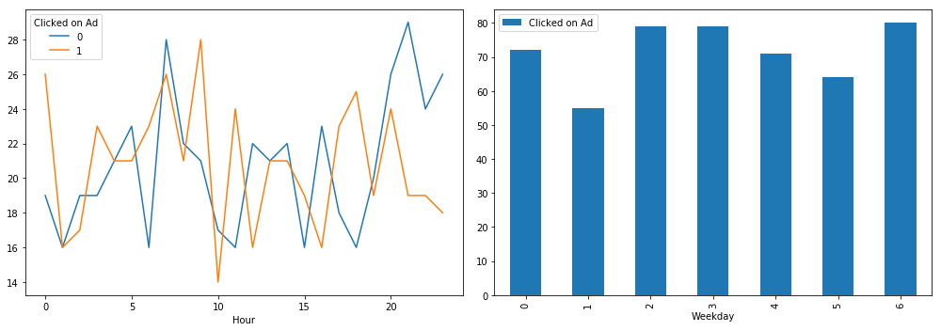
Additional features to consider
In the line chart (showing the amount of clicks or no clicks according to the hour of the day) we can see that the amount of clicks is maximized early in the day while the users who don’t click on the ad tend to be during the later hours.
Then with the bar chart (showing the amount of total clicks in each day of the week), we can see that the best days for clicks is Wednesday, Thursday, and Sunday.

Slide 8
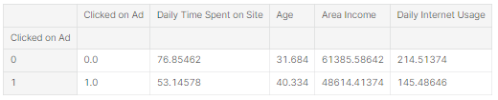
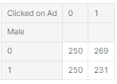
Average profile of a user who clicks an ad or not
The analysis below was done by comparing the average features of the users who click on an ad or don’t.
The average profile of a user clicking on an ad spends an average of 53 minutes on the site, have an age of 40, earns an income of about $48k, and spends about 145 minutes of daily internet usage.
Also, on average, most users clicking on an ad are female.

Slide 9
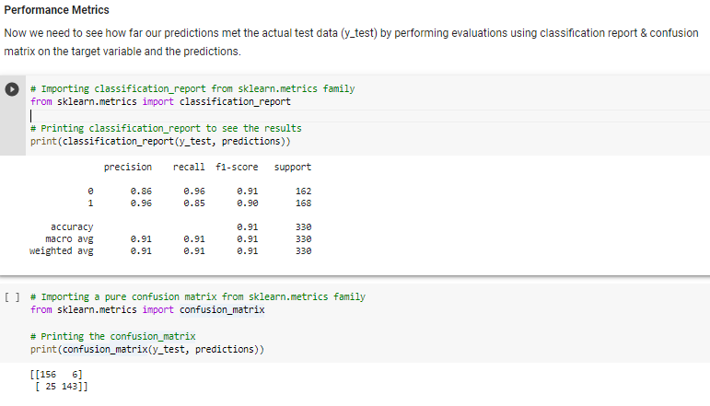
Predictions using a linear regression model
After fitting the linear regression model to the training data, running predictions, we can see the results of the model through a classification report & a confusion matrix.
The accuracy of this LRM model is averaged at 91%.
According to the CM, the users that were predicted to click on ads and actually clicked were 143 with 24 incorrectly classified , while the people who were predicted not to click on the ads and actually did not click on them were 156 with 6 users incorrectly classified.

Slide 10
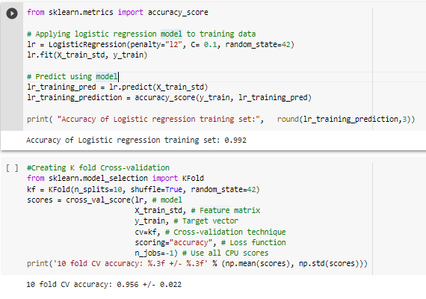
Logistic Regression Model
(training data set)
Once I’ve applied the logistic regression model to the training data and made some predictions using this model, we can see that the accuracy of this model is 0.992.
Then I used the K-Fold Cross-Validation, which gave me an average score of 0.956 over 10 folds.

Slide 11
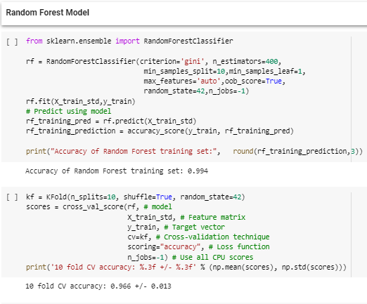
Random Forest Model
(training data set)
Once I’ve applied the random forest model to the training data and made some predictions using this model, we can see that the accuracy of this model is 0.994.
Then I used the K-Fold Cross-Validation, which gave me an average score of 0.966 over 10 folds.

Slide 12
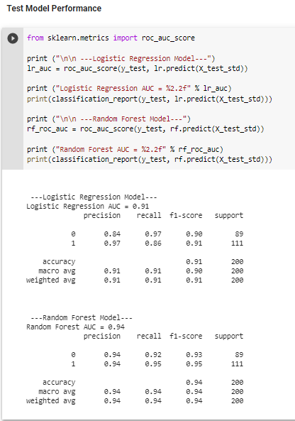
Results
Once I passed both the logistic regression & random forest model through the test data set, I concluded that the Random Forest model has a higher accuracy in both test & training data sets.

Slide 13
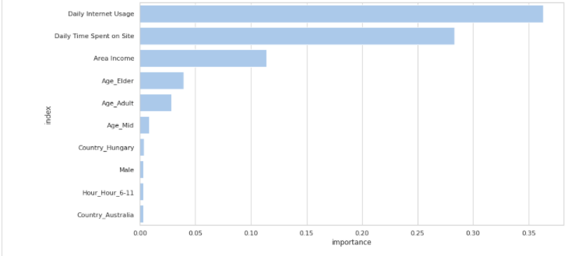
Recommendations
Below are the dominant features our Random Forest model is predicting so our target population are the people:
Who Spends less time on the internet
Who spends less time on the website
Who has lower income
Who are older than our average sample (mean around 40 years old)

Slide 14
Additional Insights
It would be interesting to see how the model will perform if we dropped the “Daily Internet User” & “Daily Time Spent on Site” features. Now we would be left with the “Age” & “Area Income” features which gives us a more niche audience to target.
As a next step in the process, I will drop the top 2 features & focus on the “Area Income” & “Age” features to draw more specific insights on finding a target audience for our ads.
Possibly break each feature down to specific categories
“Age”: Young, Adult, Mid, Elder
“Area Income”: $0-$20k, $30k-$60k, $70k or greater

Slide 15
Questions?

